Slide 1
Guidelines for preparing a Project Outline
Call 2 PO Preparation Days, Brussels, 23 September 2015
Marc Sturzel – Programme Coordinator ITEA 3

Slide 2
Submission process
Proposals content
Website

Slide 3
PO / FPP differentiation

Slide 4
PO Stage
Create a convincing story
Push innovation for actual market impact
Explain the concept and consortium relevance
Present clear objectives
PO / FPP differentiation
FPP Stage
Refine the PO thanks to the evaluation feedback
Propose a convincing realisation plan

Slide 5
Offline & Online inputs

Slide 6
Offline & Online inputs

Slide 7
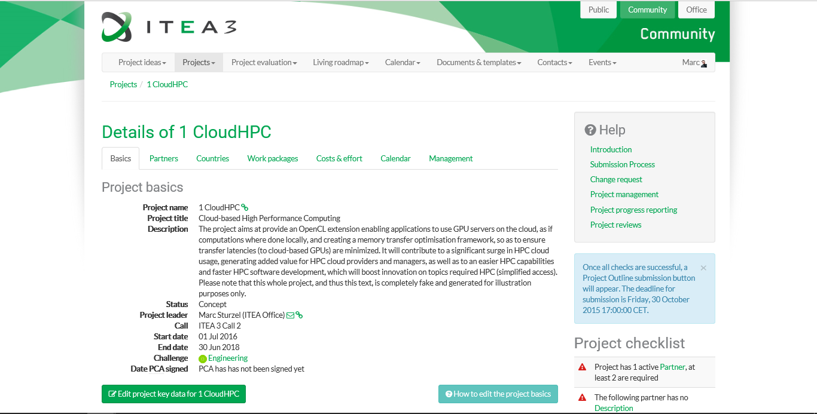
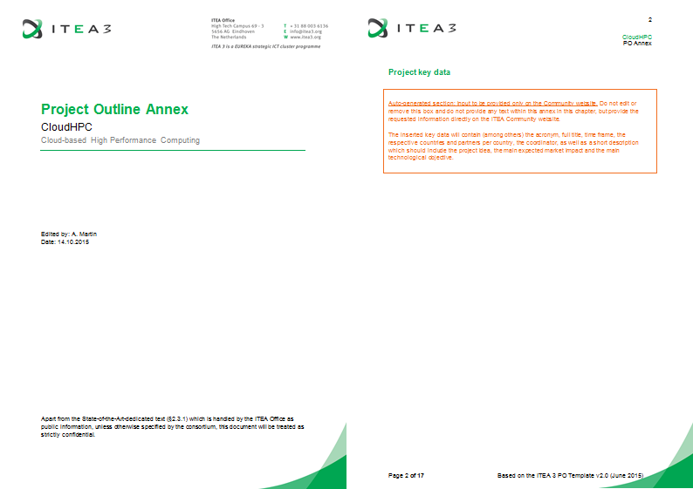
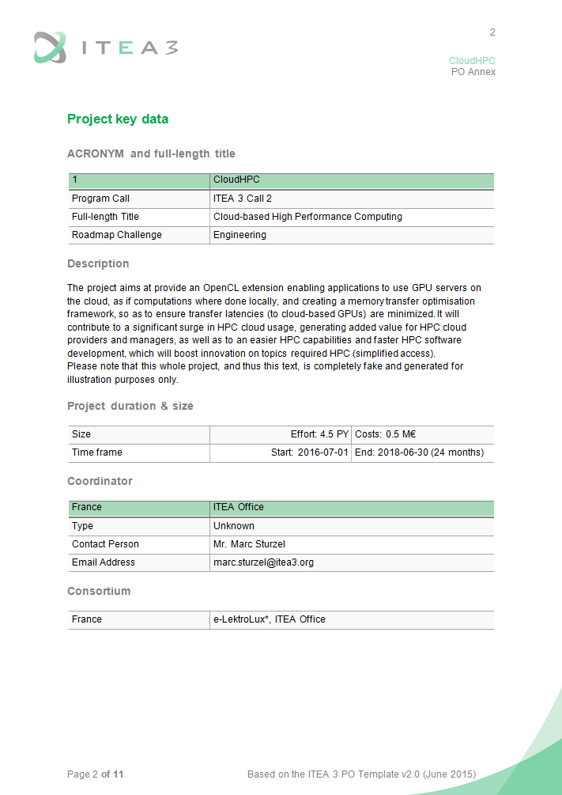
Offline & Online inputs
Administrative inputs
PO Annex
Merged proposal
https://
editable
.docx
editable
.docx
read-only

Slide 8
PO template

Slide 9
PO template

Slide 10
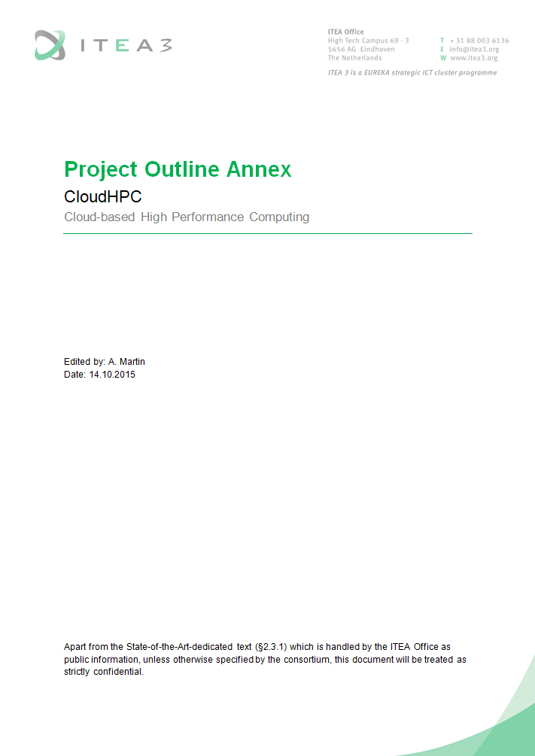
PO template

Slide 11
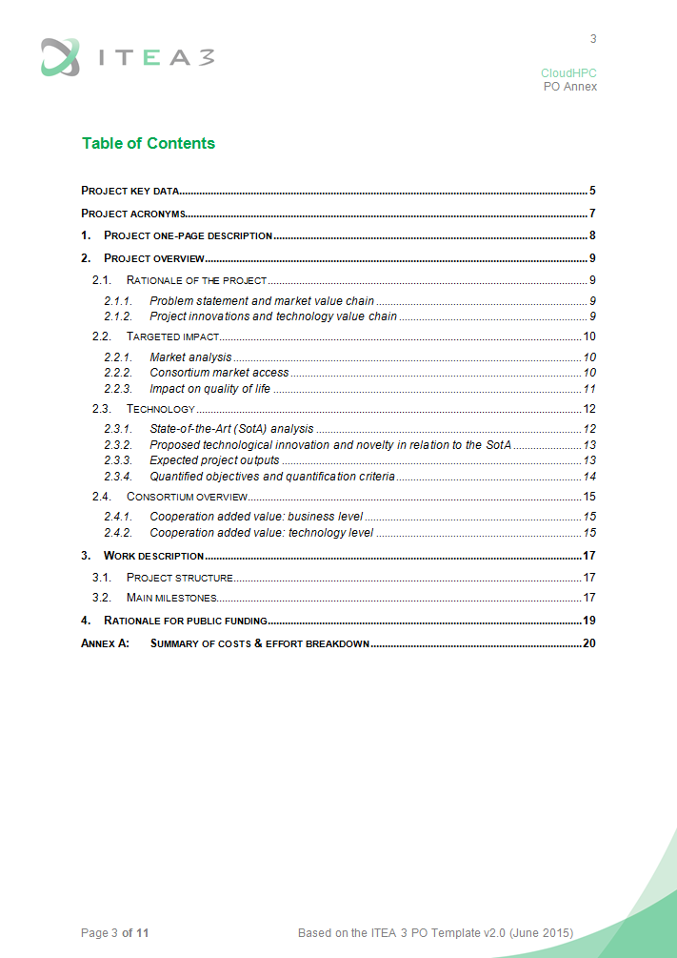
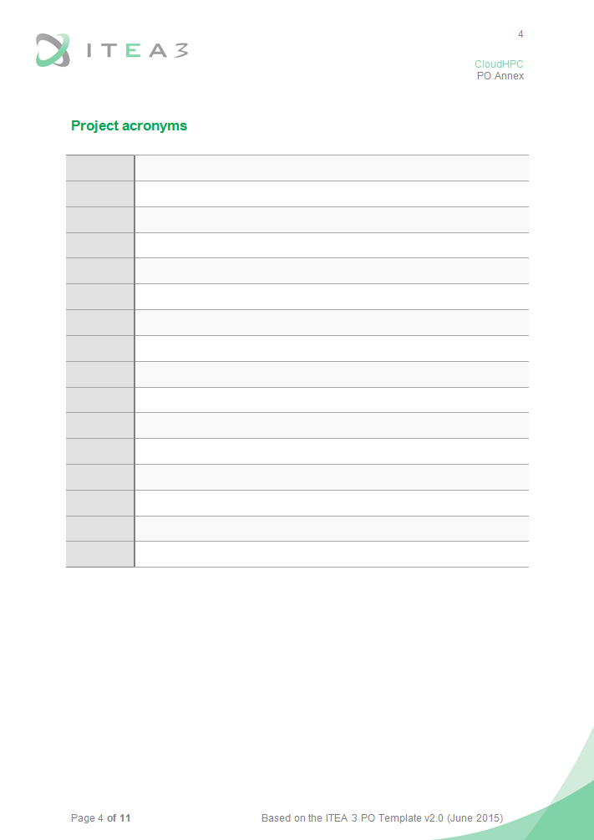
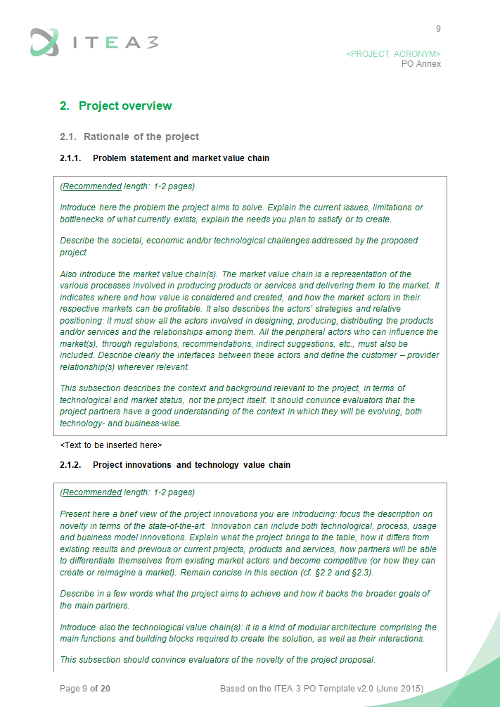
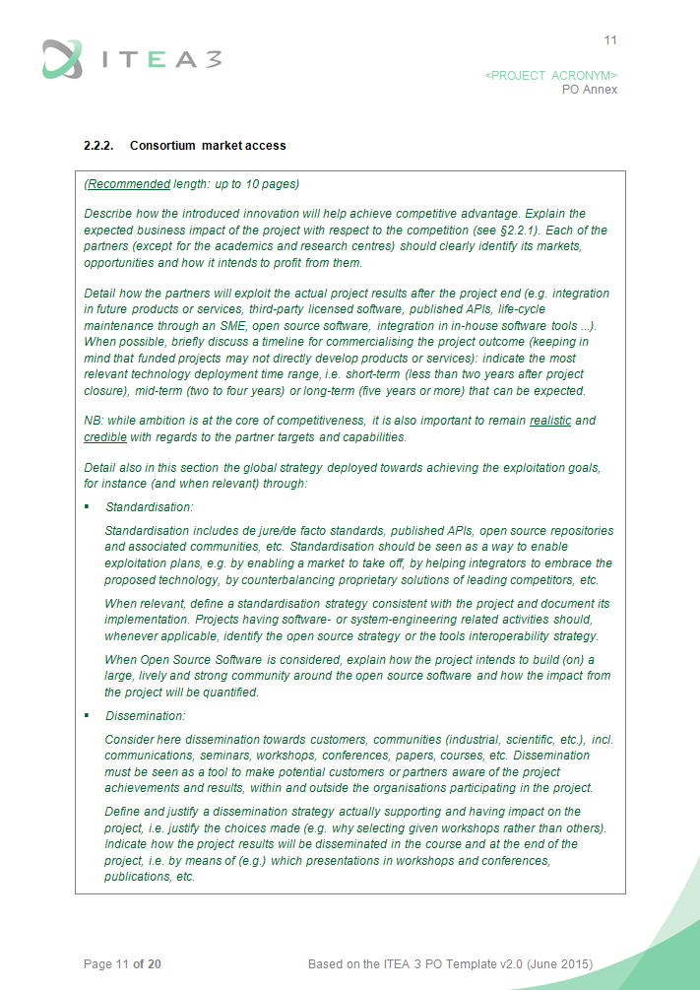
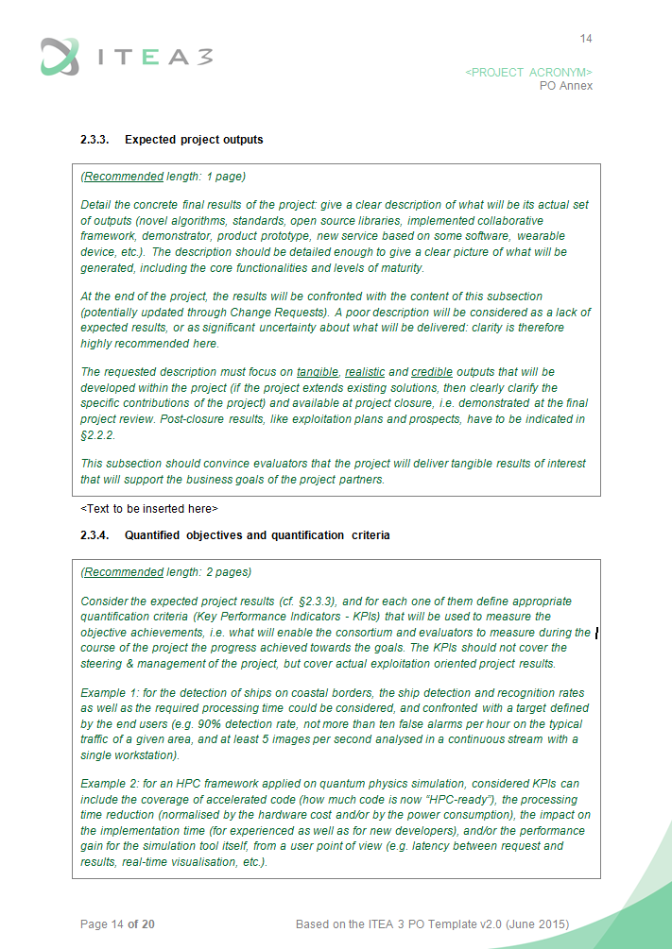
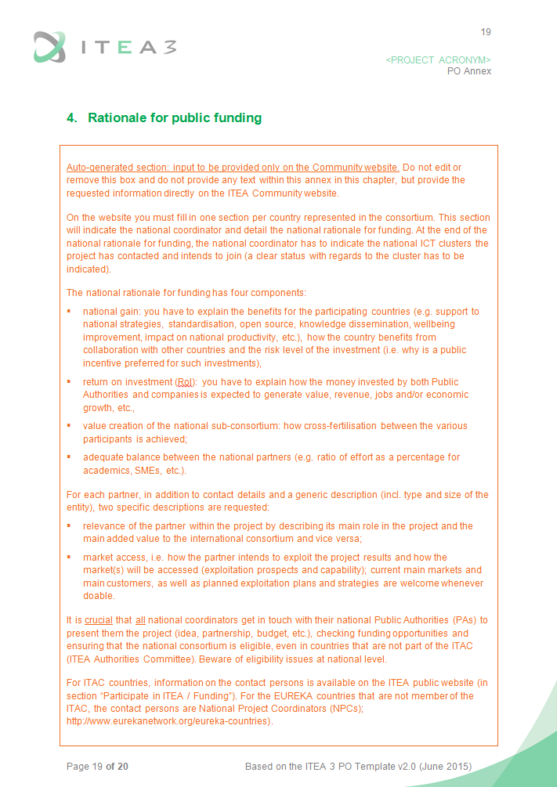
PO template
Overall length constraint up to §4 excl.:
45 pages for a PO
75 pages for an FPP (without instructions and merged sections)

Slide 12
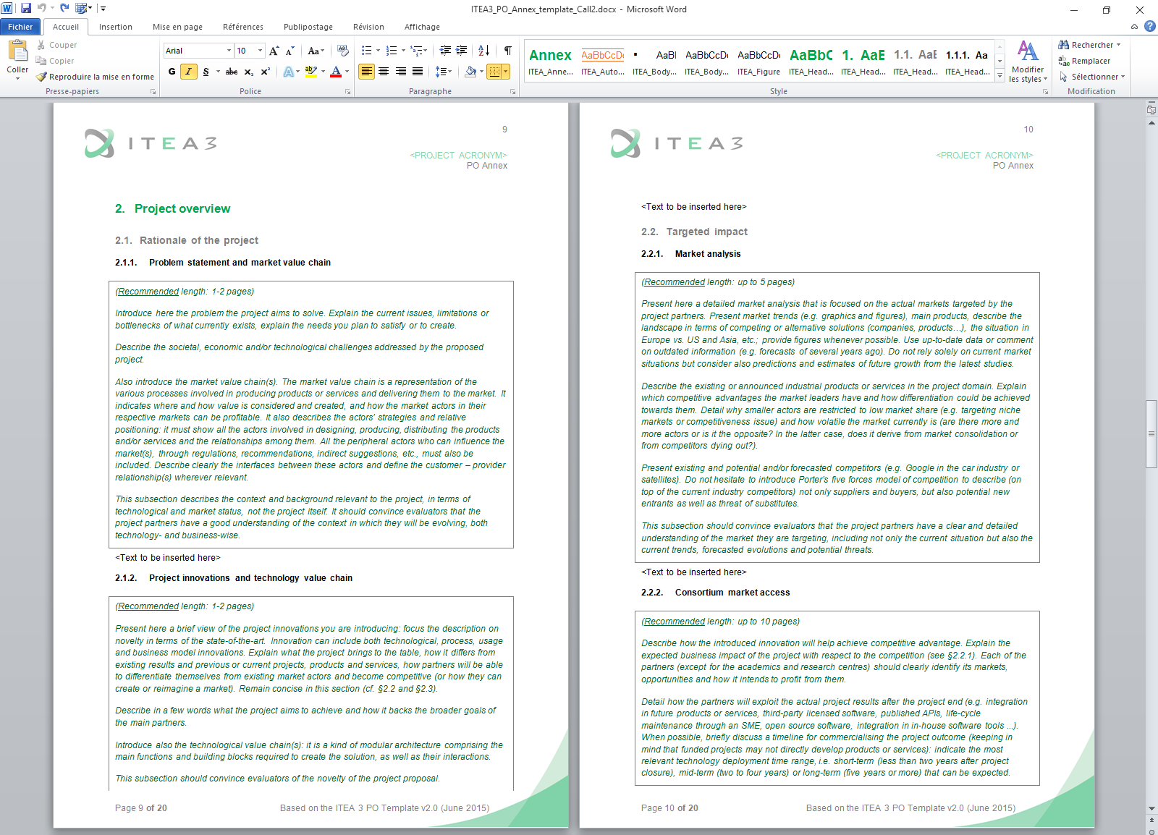
PO template

Slide 13
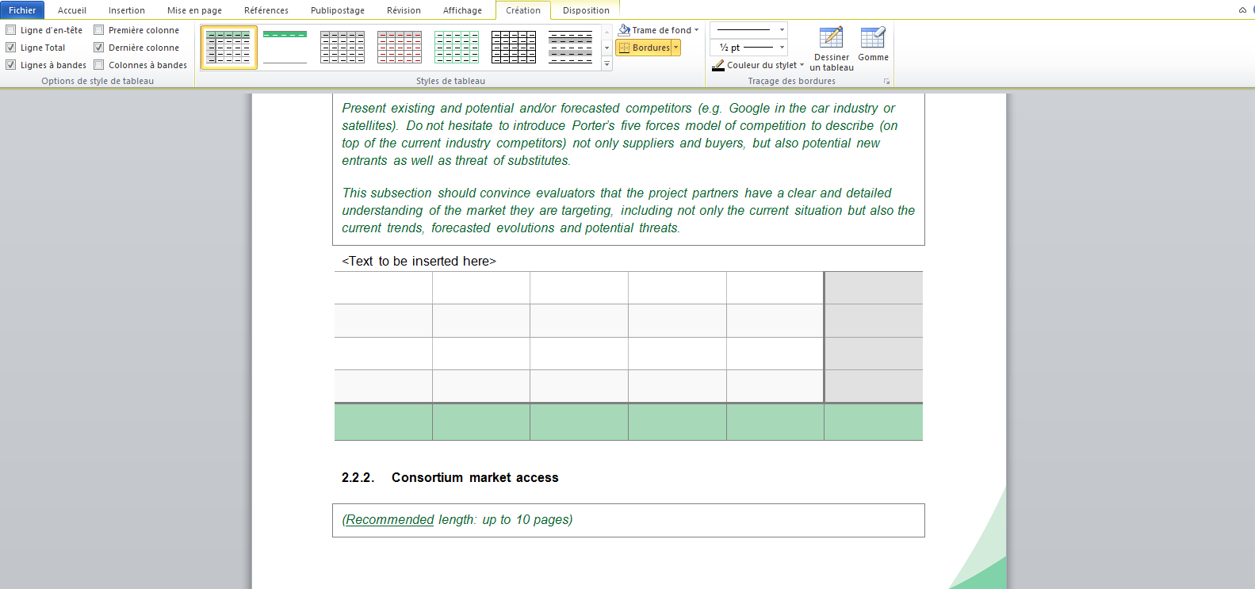
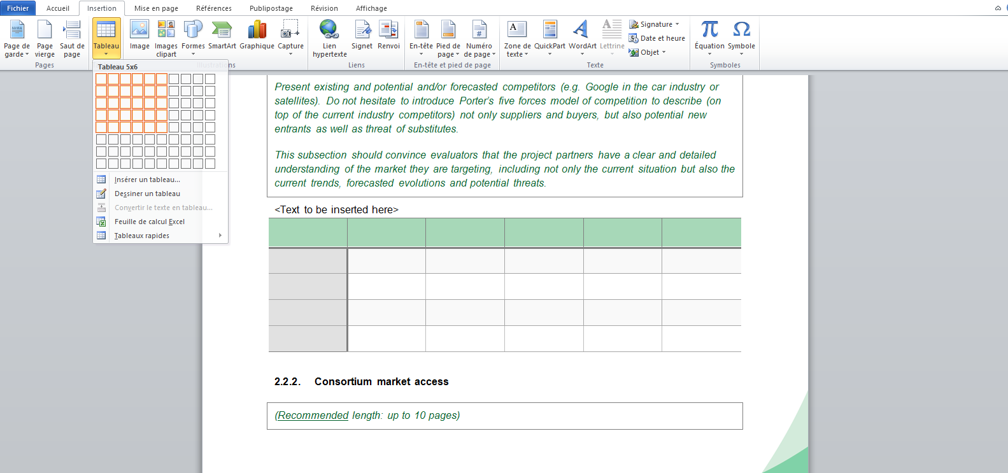
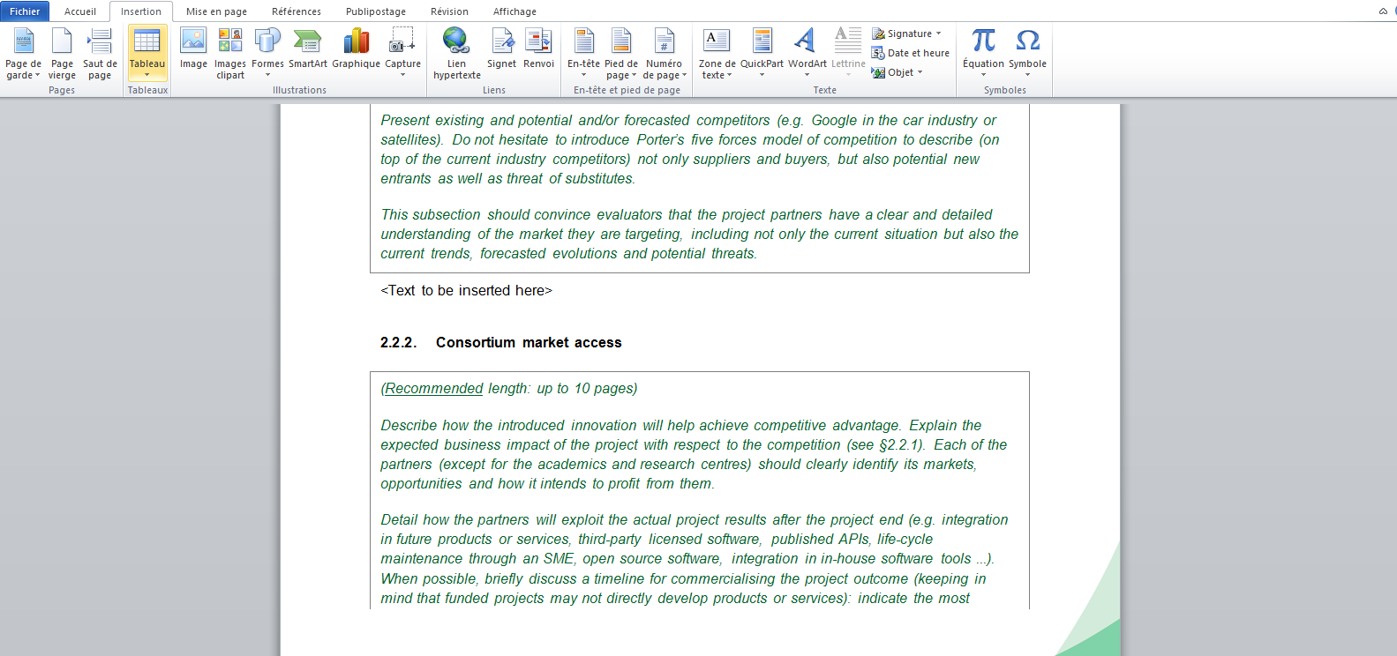
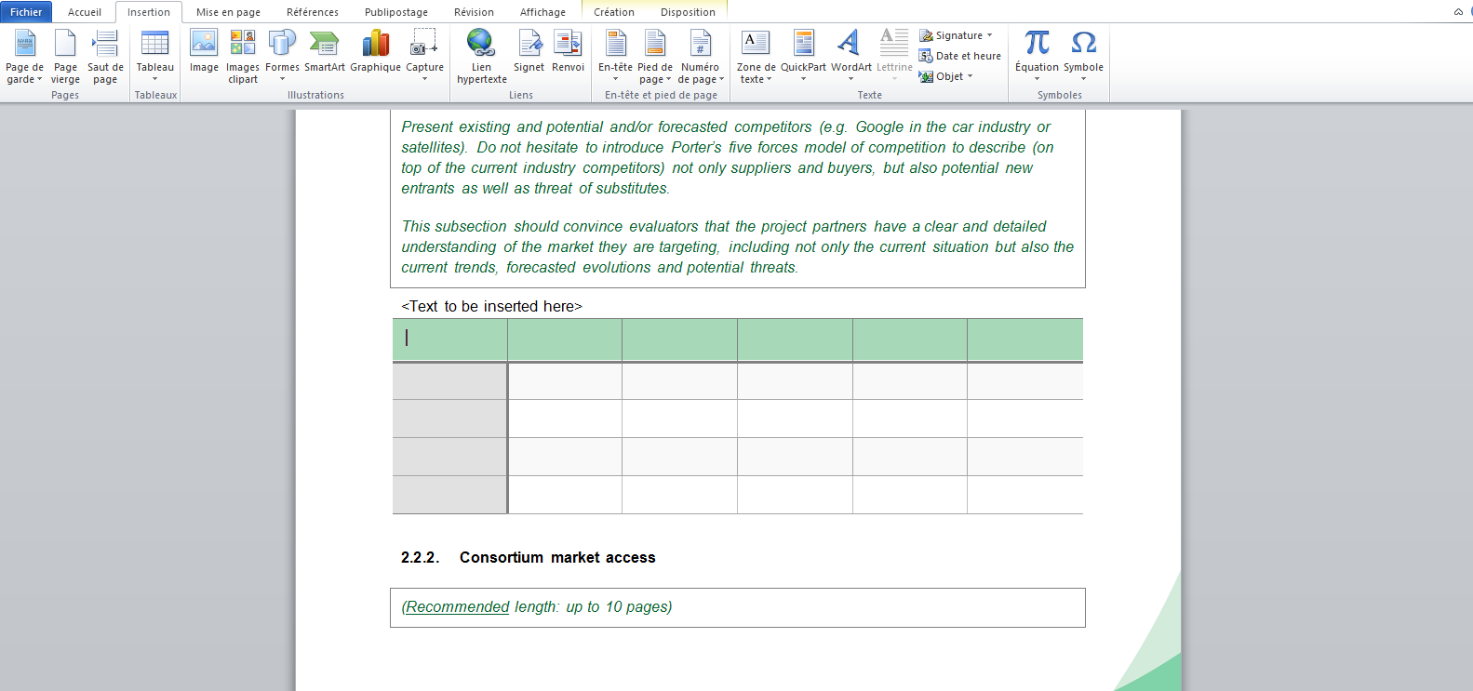
PO template

Slide 14
PO template merge

Slide 15
PO template merge

Slide 16
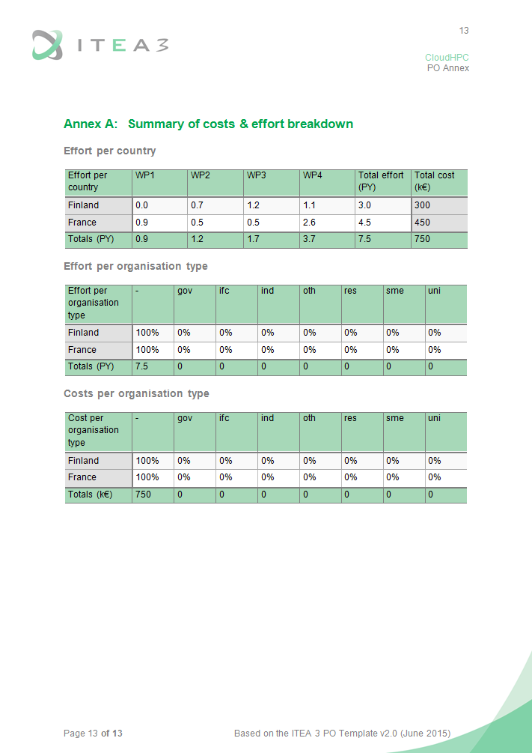
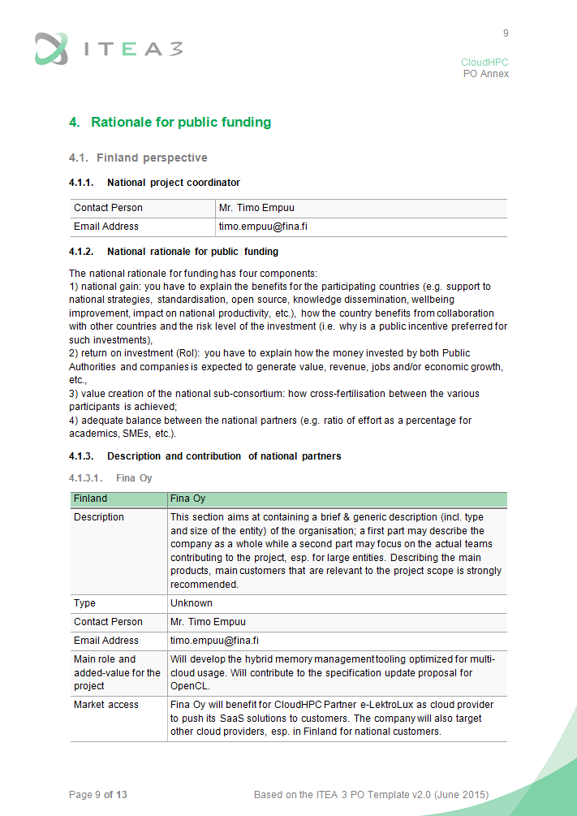
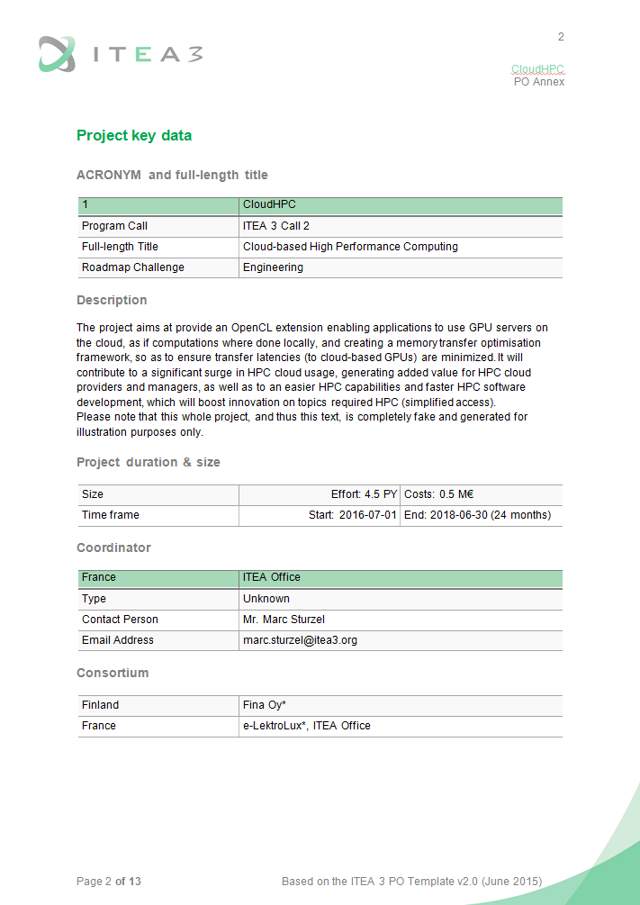
PO template merge

Slide 17
PO Annex Guidelines

Slide 18
PO Annex Guidelines

Slide 19
PO Annex Guidelines
Market Value Chain(s)
4G/LTE network provider
provides the network and the bandwidth
provides a service / a selling point
Corporate IT personnel
Secured mobile video streaming service provider
Regulations
Constraints & needs
Constraints
provides the security overlay
provides the Cloud
infrastructure
Encryption provider
Cloud provider
Adoption
Explain how the market value chains are covered
End-users
Fake example defined for illustration purposes

Slide 20
PO Annex Guidelines
Technology Value Chain
Data simulation
Artificial Intelligence
Compression optimisation algorithm
Models and frameworks
Real-time profiling
Encryption
Cloud HPC platform
Streaming service
with cloud compression
Mobile apps
Explain how the technology value-chain is covered
Fake example defined for illustration purposes

Slide 21
PO Annex Guidelines
Consortium Market Access
Business expectations
New combination of technologies
Think global!
Market opportunities
New concepts
Threats of substitutes
Technology disruptions
Threats of new entrants
Upstream research
Market Analysis
Innovation
Current market situation
Expected market trends
Competitor strategies
Existing products
Current SotA
Technology trends
ITEA Living Roadmap

Slide 22
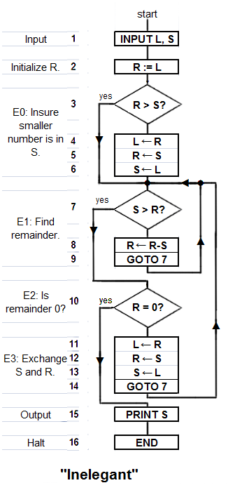
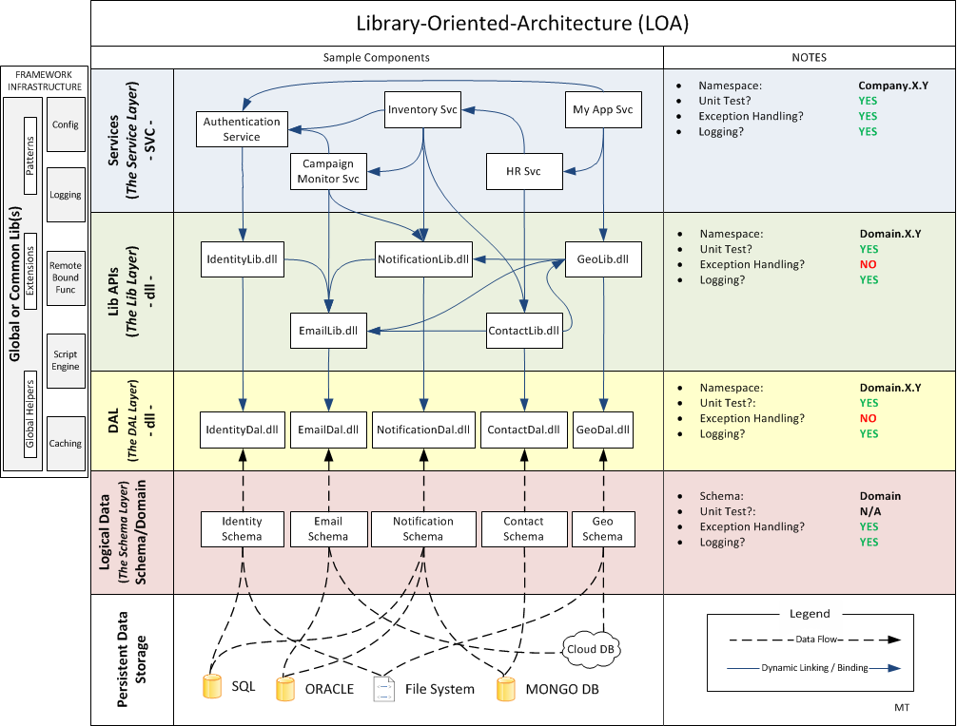
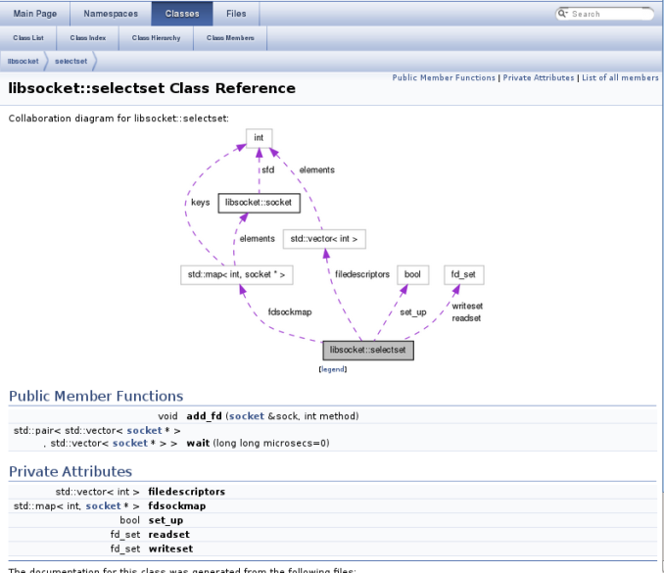
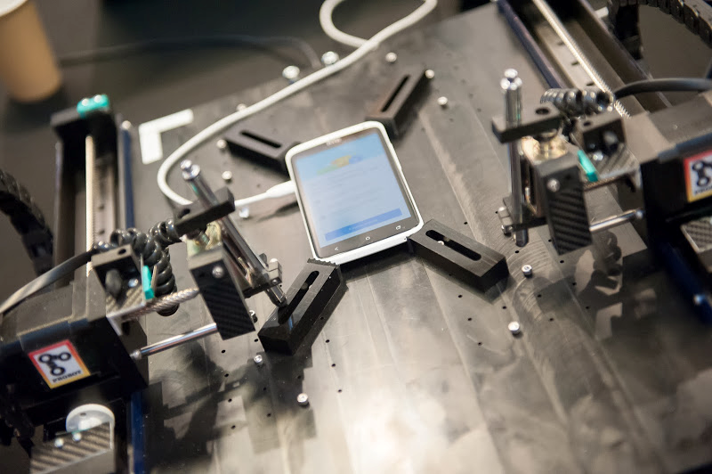
PO Annex Guidelines
Clear Objectives and Outputs
Examples:
Novel algorithms
Software architectures
Open Source libraries
Demonstrators
Prototypes
Contributions to standards
Etc.
Tangible, realistic, ambitious

Slide 23
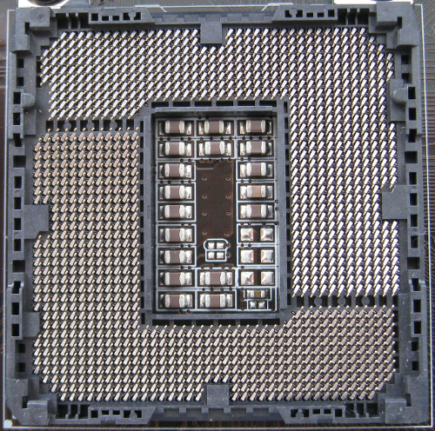
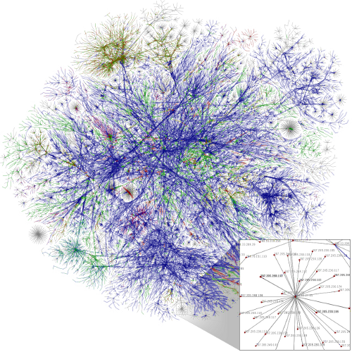
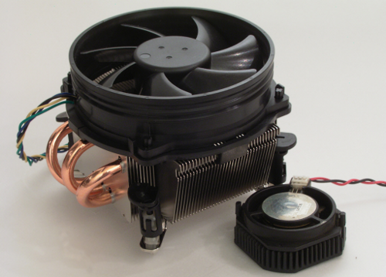
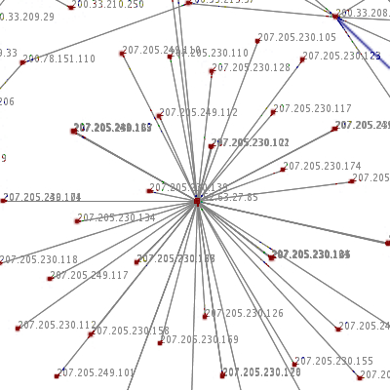
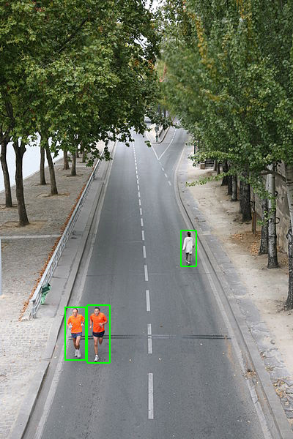
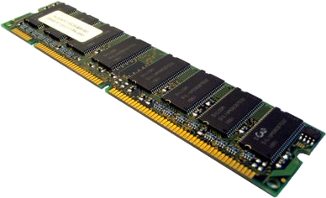
PO Annex Guidelines
Quantification Criteria
Examples:
Consumption (GPU, RAM, heat…)
Frame rate (HW dependent)
Algorithm performances
Scalability
Maturity
Etc.

Slide 24
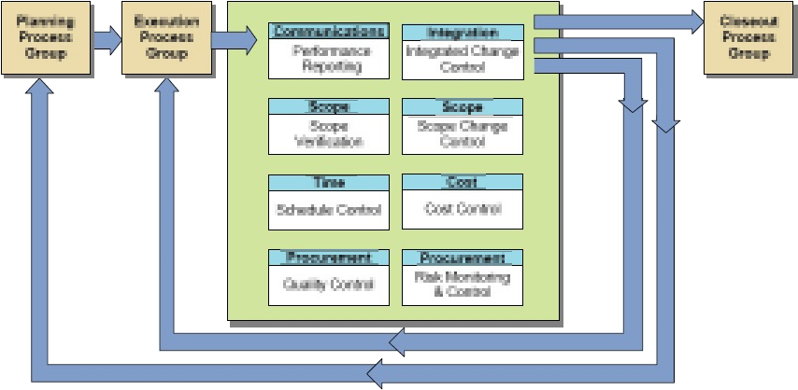
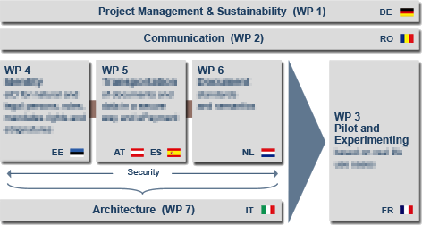
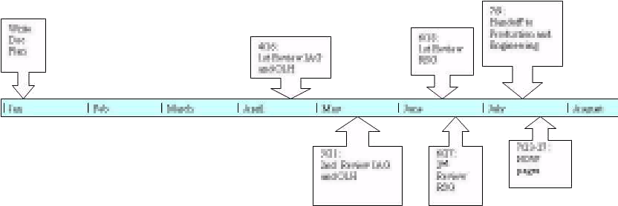
PO Annex Guidelines
Clear structure
At PO stage, only provide:
the project structure
the milestones

Slide 25
ITEA websites

Slide 26
ITEA websites

Slide 27
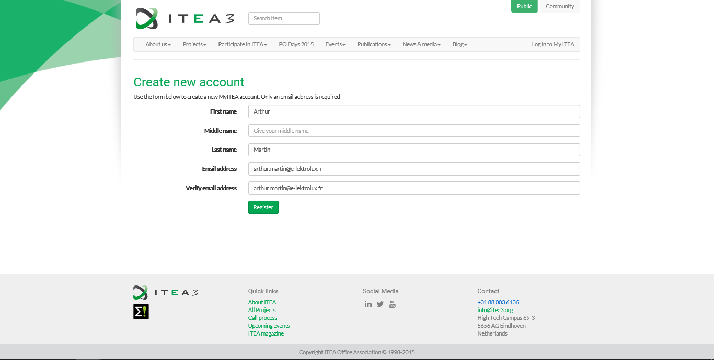
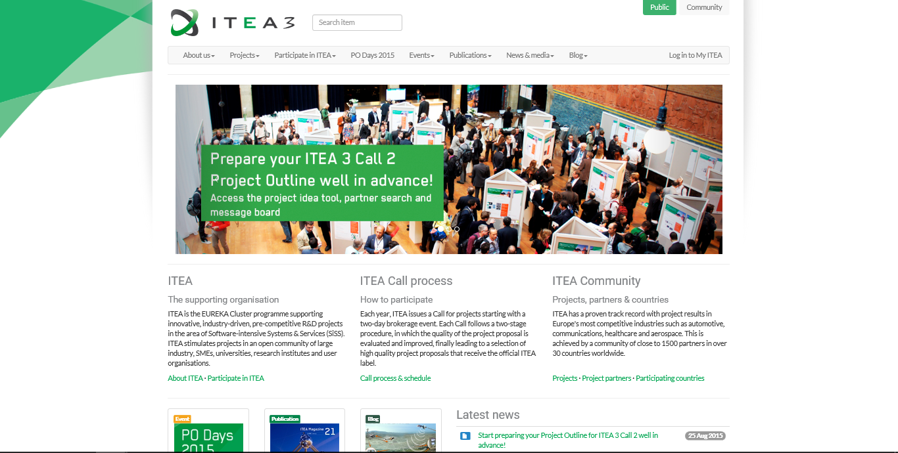
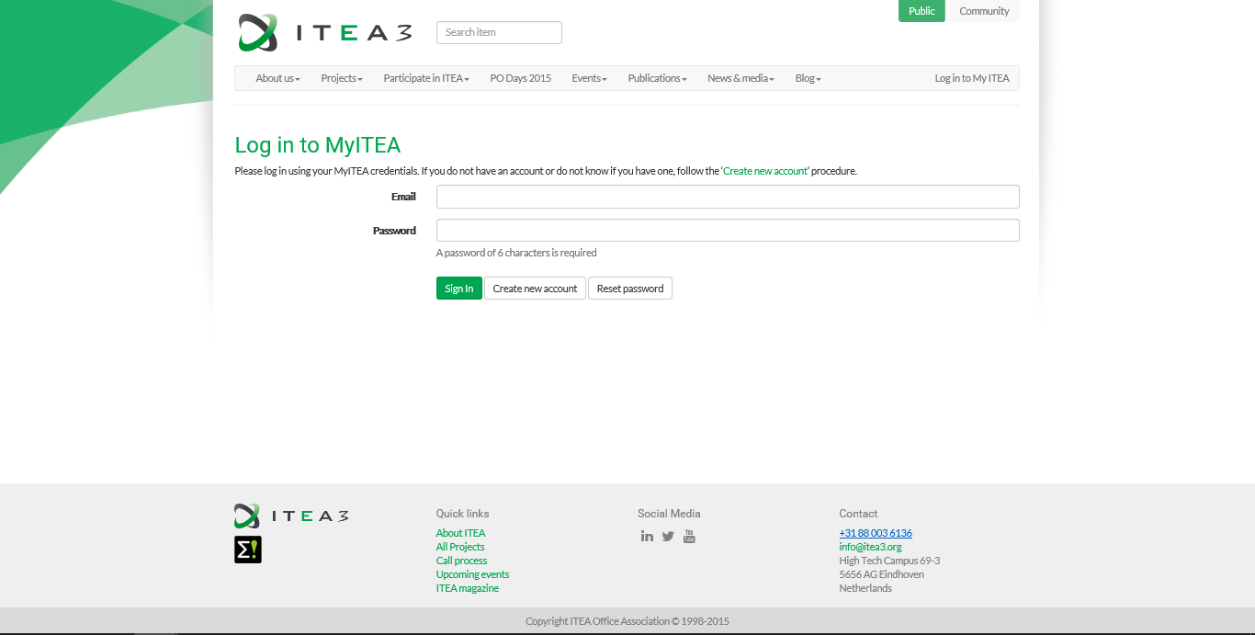
ITEA websites

Slide 28
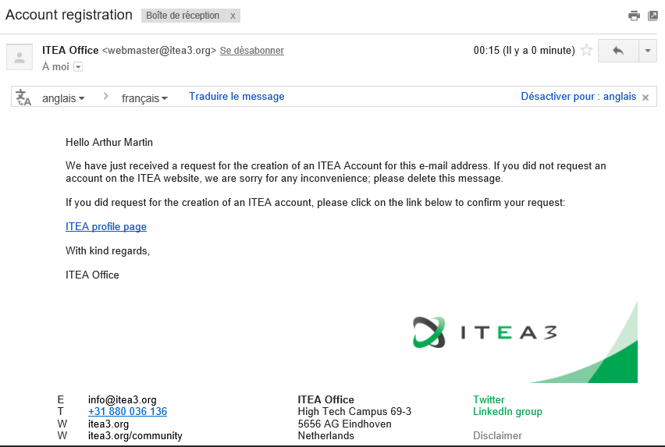
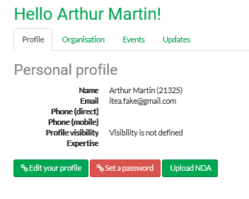
ITEA websites

Slide 29
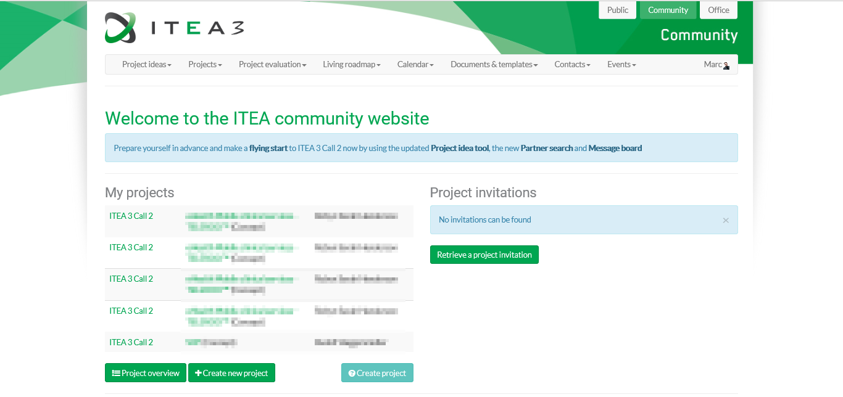
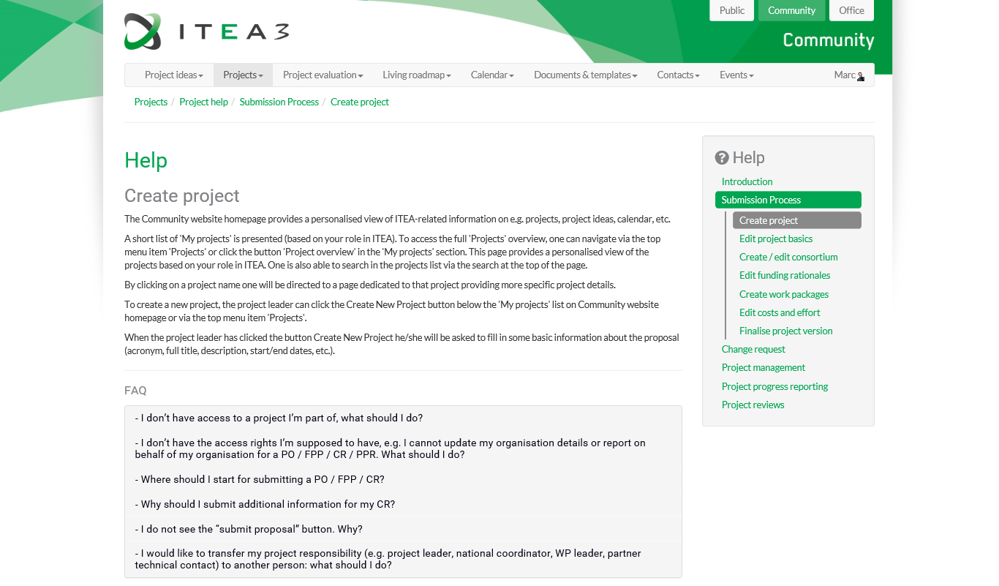
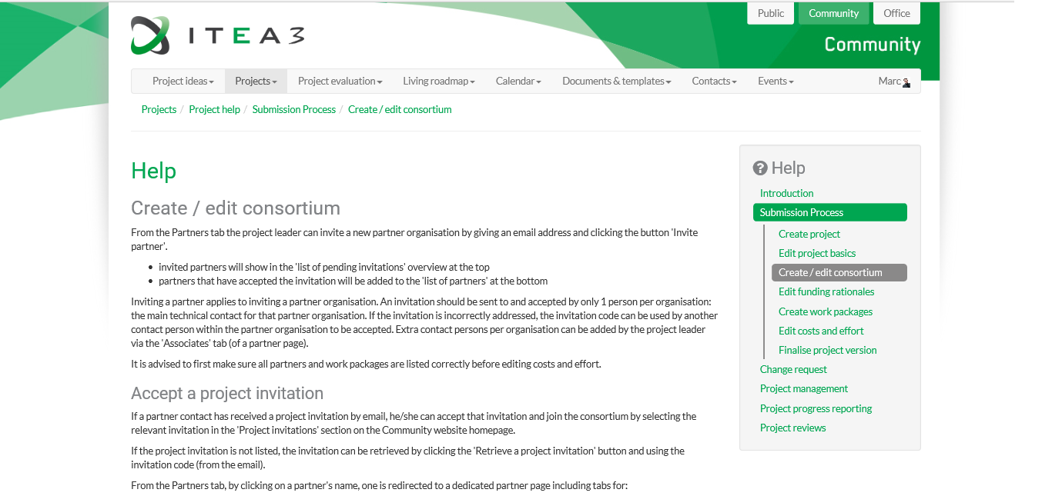
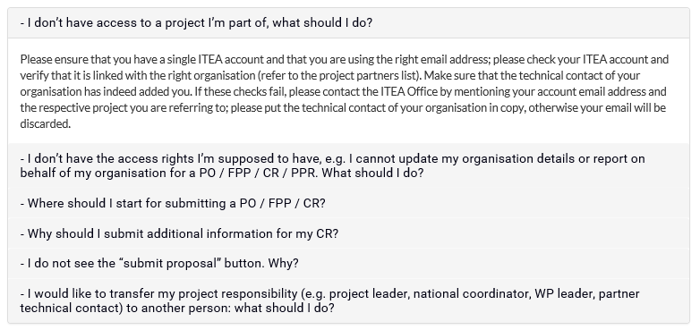
ITEA websites
Project coordinator

Slide 30
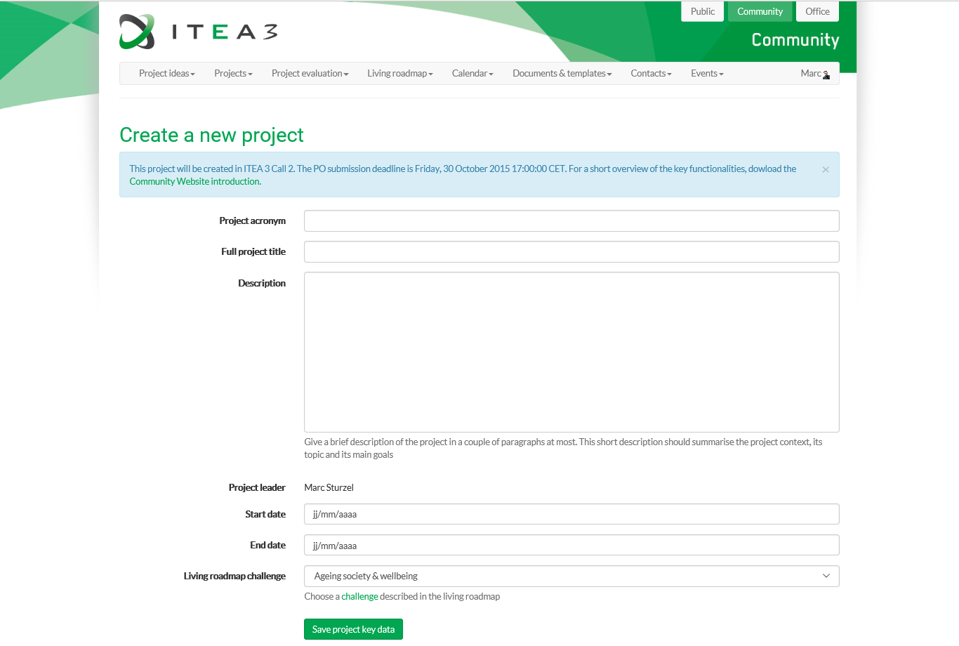
ITEA websites
Project coordinator

Slide 31
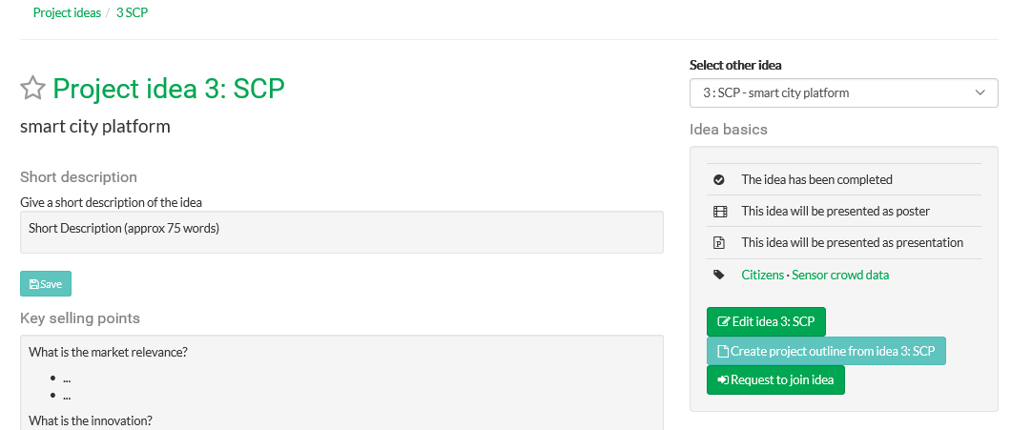
ITEA websites
Project coordinator

Slide 32
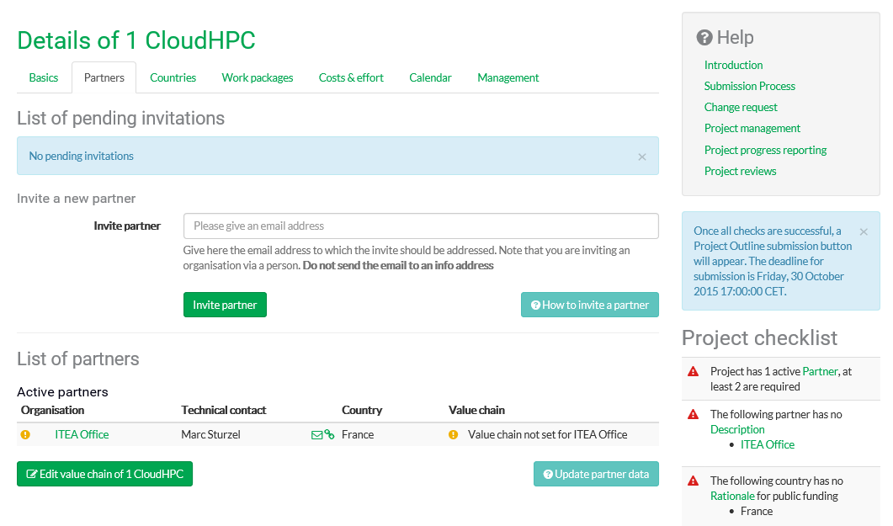
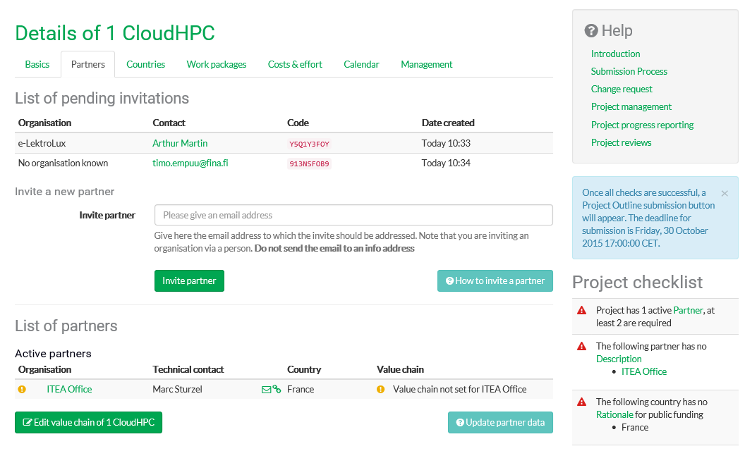
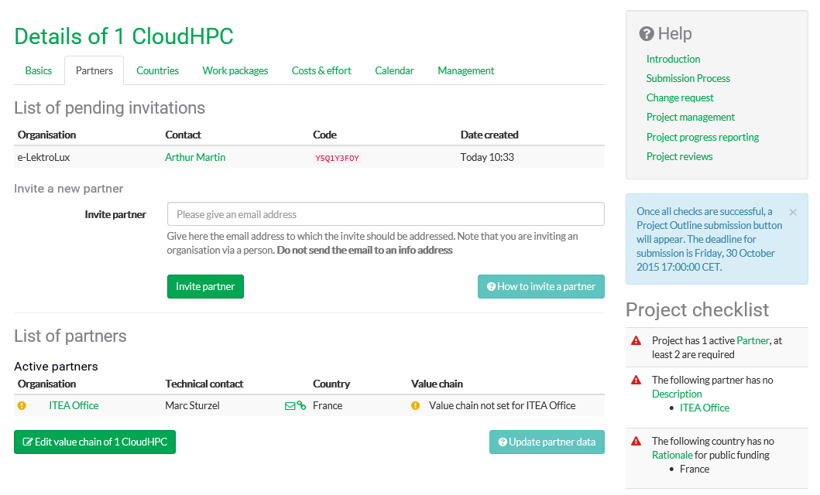
ITEA websites
Project coordinator
By default, subcontractors are not partners

Slide 33
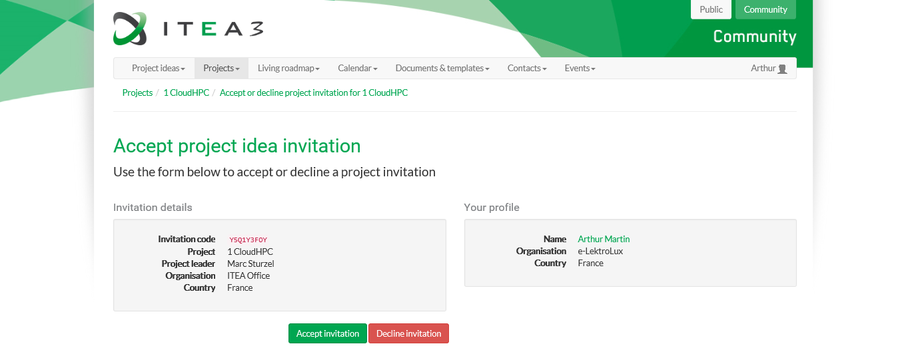
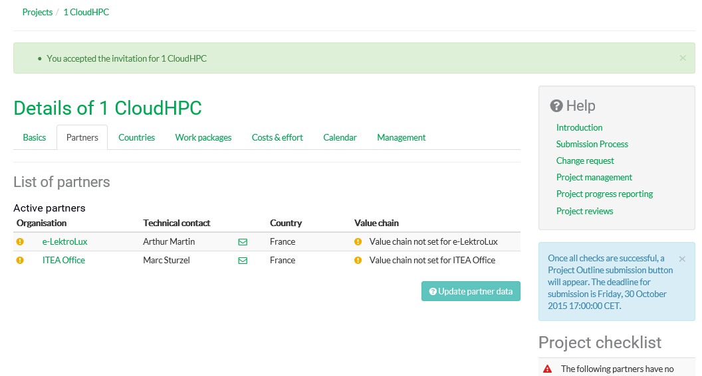
ITEA websites
Invited partner

Slide 34
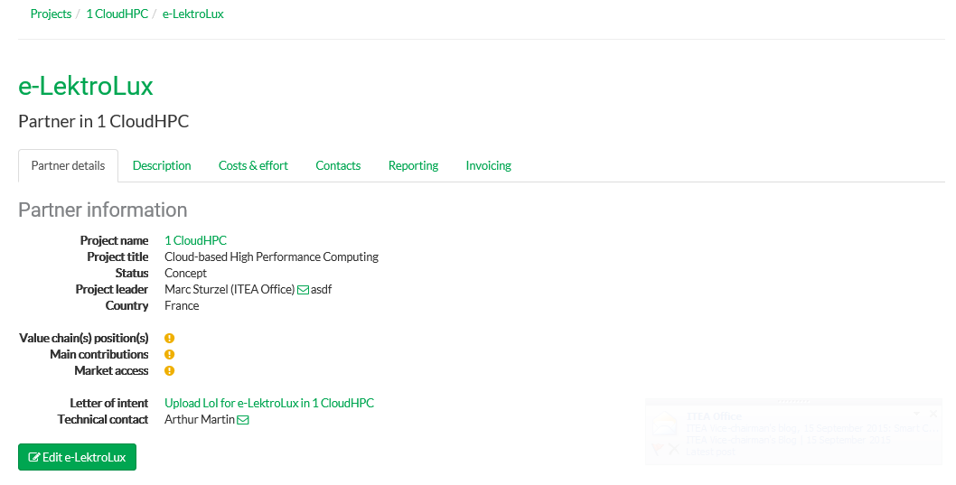
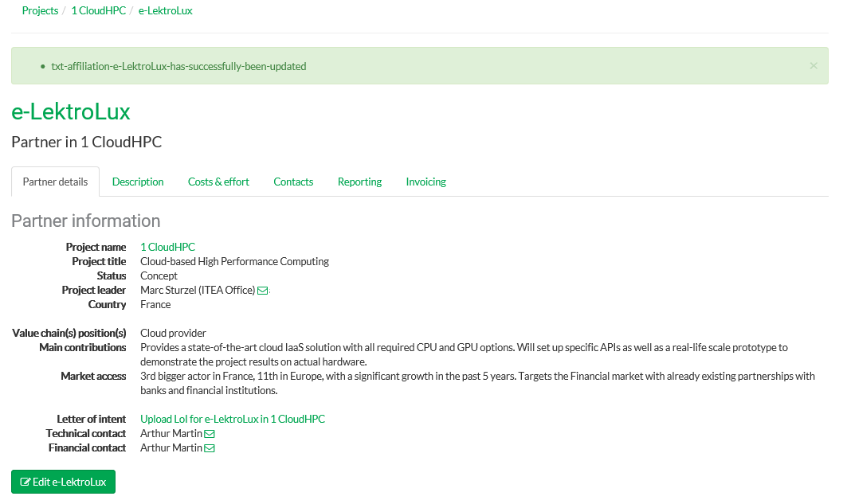
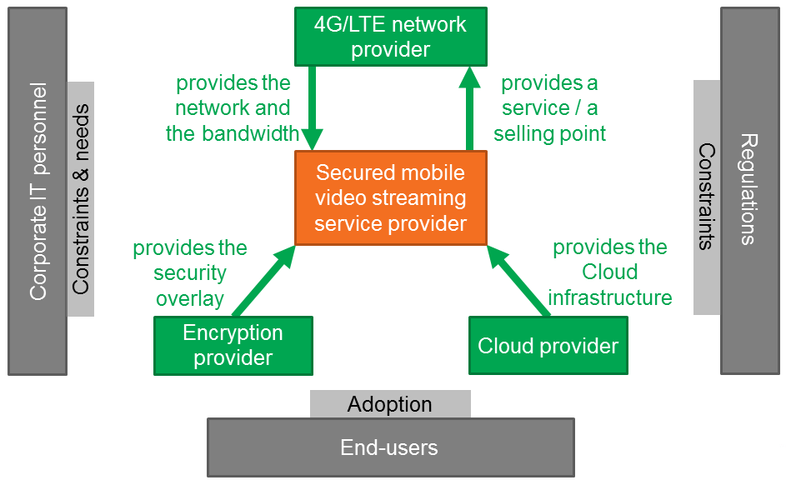
ITEA websites
Each partner

Slide 35
ITEA websites
National coordinators
The project leader fills in the names of national coordinators and WP leaders

Slide 36
ITEA websites
Project coordinator
Merged proposal
Preview:
read-only
Notes:
Messages:
- To be on the safe side, submit your PO at least once a few days before the deadline

Slide 37
ITEA websites
Project coordinator
You can submit your PO as many times as you want until the deadline is met

Slide 38
For any advice or coaching,
do not hesitate to contact the
ITEA Programme Coordinators
For any general question or support: info@itea3.org

Slide 39
Thank you for your attention

