Slide 1
WP3 Development and Implementation
Development of the matchmaking systems and TERCA model
Deliverable 3.3
(Related Tasks T 3.1)

Slide 2
Objective
The Matchmaking system is a platform that supports the realization of ideas among stakeholders involved health games/apps. This facilitates development process from the idea stage to the implementation, verification and business.
Stakeholders
SW Companies
They develop health-related games and apps. Also, they want to find the right clinic or hospital to test their application.
Health institutions
They study to solve health-related problems and verify the therapeutic effectiveness of the solutions developed.
Idea owners
Anyone who has ideas to solve health problems.

Slide 3
Scenarios 1. Idea or app registration
Idea owner
Researcher
(Health Institution)
Medical Advisory Board(PGP)
Idea realization
Ideas
Input data
Matchmaking System
Evaluation
(TERCA model)
decision
Publication
Users can view
App registration
Health
Apps/Games
Input data
Clinical Trials
By user request

Slide 4
Scenarios 2. Find a suitable solution of my problem - recommendation
Health Institution
Matchmaking system
App Stores,
External sites
Keyword search
For Apps/Games
Display ideas, Apps, and Games
Check reviewer’s comments, OWL Scores
Problems
Download
I want to solve ~~
Select filter
For Ideas
Disease, Cognitive disability
Ex. Dementia, MCI, Autism
Contact owner

Slide 5
Scenarios 3. Evaluate the register ideas or apps
Idea owner
Researcher
(Health Institution)
Medical Advisory Board(PGP)
New ideas
Input data
Ideas
Matchmaking System
Evaluation
(TERCA model)
Find a developer
Go public
Feedback or request data
Elaborate ideas
Technical and clinical

Slide 6
User Flow
User
1.0.0
Sign up
2.0.0
Sign in
2.1.0
lost password
2.1.1
Edit info.
Legend
3.0.0
App list
3.1.0
App Detail
4.0.0
Register App
1st step
3.1.3
edit reviews
2nd step
3.1.1
Review list
3.1.2
Write reviews
Delete review
5.0.0
MyPage(M)
5.1.0
App Management
5.1.1
List of Apps
5.2.1
Assign reviewers
5.1.2
Edit App contents
5.2.0
Manage reviews
5.2.1
List reviews
5.1.2
Edit review
5.3.0
Edit(M)
5.3.1
Password
5.4.1
Edit profile
5.4.2
Sign Out

Slide 7
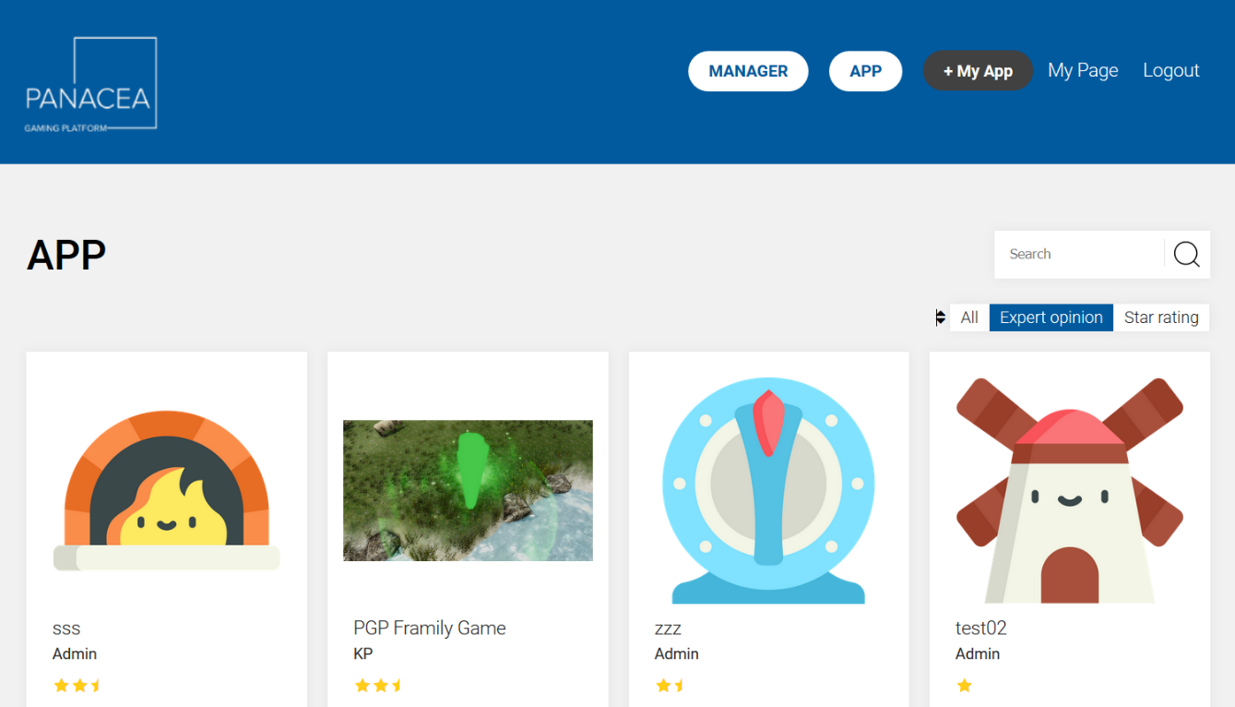
User profile, registered app
Registered App
Click change to detail screen
Go to “Manager”
App List
keyword search
Filter

Slide 8
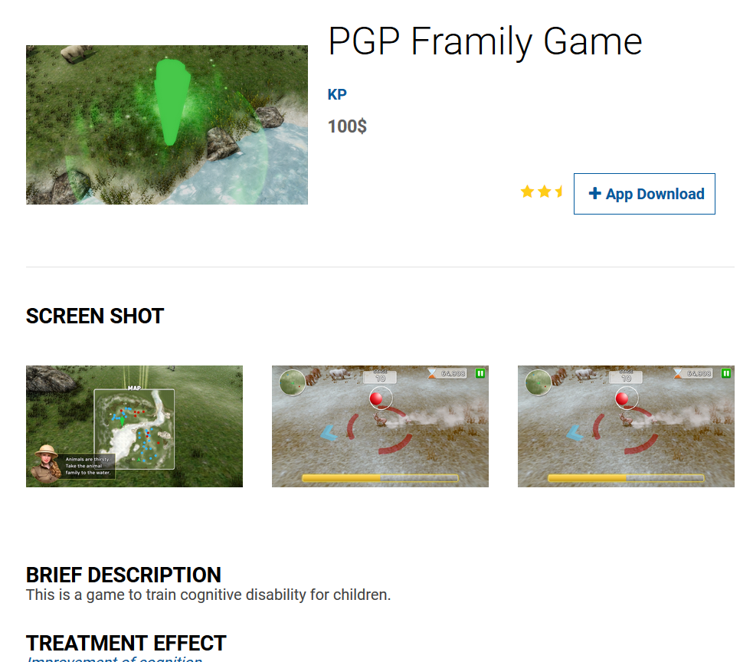
App Detail 1
Overall OWL Score by TERCA model
Download link
Captured screens
Input items
OWL Score by TERCA model

Slide 9
App Detail 2
Detail of App
Write expert review if you have a permission
OWL Score by TERCA model
Expert review
(user can select each item in TERCA model)

Slide 10
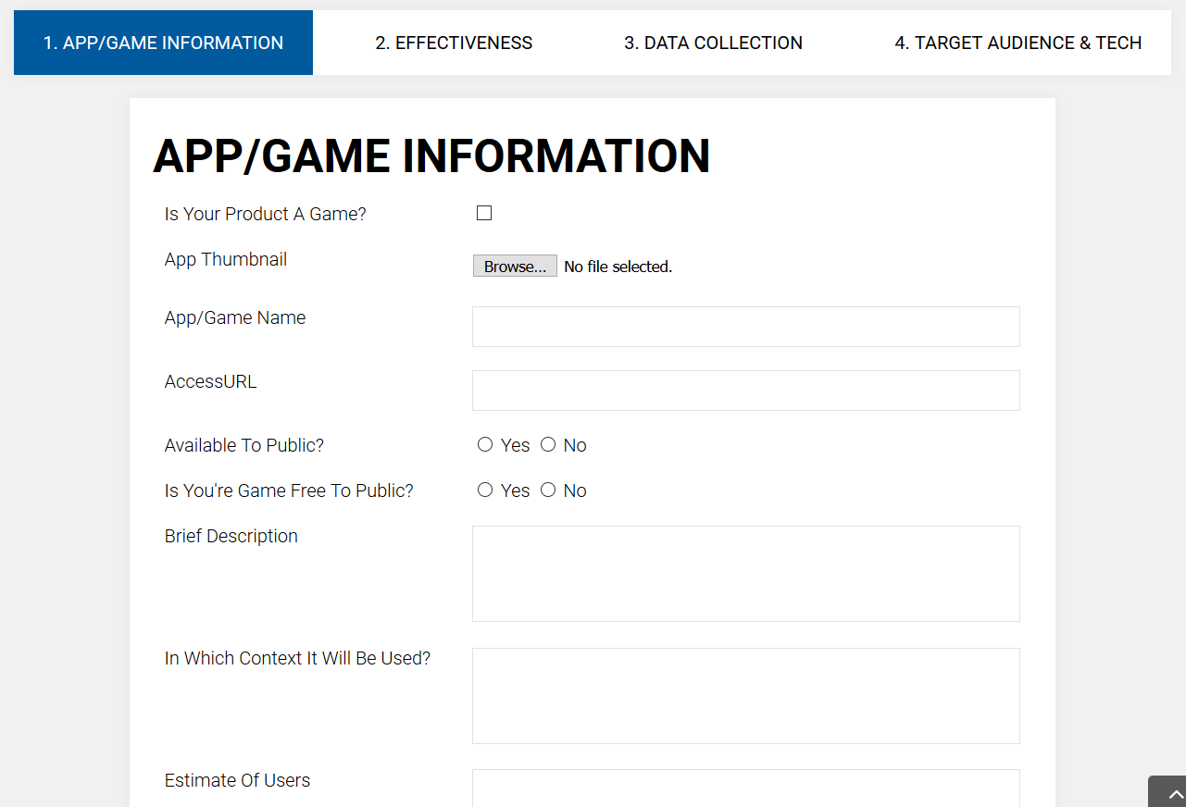
Treatment
User data collection
Technology, Target (patients)
Registration of Idea/App
Basic information
Icon, captured image
Input items

Slide 11
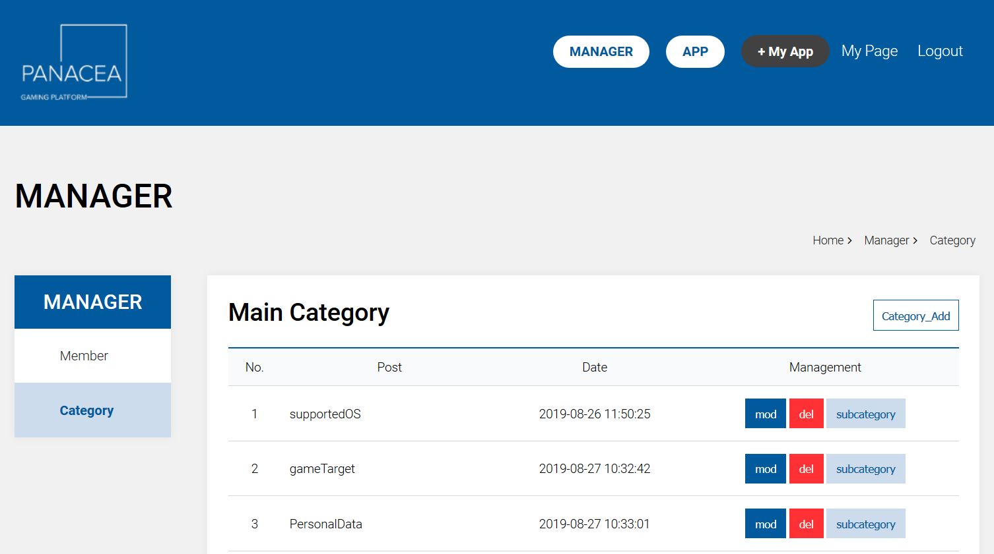
Manager
Change or add, delete input items
Menu
Change member group, permission

Slide 12
Review (TERCA Model)
Executive summary
TERCA review
Technology
Engagement
Research
Clinical
Assessment
OWL Score of each TERCA model
OWL Score by TERCA model

